Slide 1
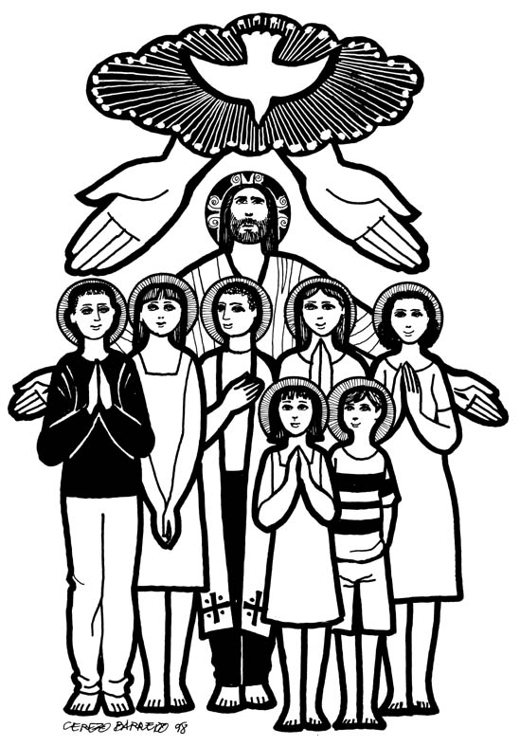
PRELUDE
Air on the G String J.S. Bach
Debby Brady, guitar
Please prepare for worship by
opening your heart,
lowering your voice
and silencing
your cell phone.

Slide 2

November 7, 2021
Welcome! ¡ Bienvenido

Slide 3
ALL SAINTS GREETING
A: We gather to worship the One who crafted
creation out of chaos,
C: our cries of joy join the anthems of the
universe.
A: We gather to lift our praise to the God who
gives us voice,
C: we bring the songs which have echoed
in our hearts all week long.

Slide 4
ALL SAINTS GREETING
A: We gather as the children of God, our
joy unbroken in God's love.
C: young and old, tone deaf and
perfect-pitched, lift the new, new
songs of faith.

Slide 5
GATHERING SONG
Day by Day
Red Book # 790
1 Day by day, your mercies, Lord, attend me,
bringing comfort to my anxious soul.
Day by day, the blessings, Lord, you send me
draw me nearer to my heav'nly goal.
Love divine, beyond all mortal measure,
brings to naught the burdens of my quest;
Savior, lead me to the home I treasure,
where at last I'll find eternal rest.

Slide 6
GATHERING SONG
Day by Day
Red Book # 790
2 Day by day, I know you will provide me
strength to serve and wisdom to obey;
I will seek your loving will to guide me
o'er the paths I struggle day by day.
I will fear no evil of the morrow,
I will trust in your enduring grace.
Savior, help me bear life's pain and sorrow
till in glory I behold your face.

Slide 7
GATHERING SONG
Day by Day
Red Book # 790
Oh, what joy to know that you are near me
when my burdens grow too great to bear;
oh, what joy to know that you will hear me
when I come, O Lord, to you in prayer.
Day by day, no matter what betide me,
you will hold me ever in your hand.
Savior, with your presence here to guide
me, I will reach at last the promised land.
Text: Carolina Sandell Berg, 1832-1903; tr. Robert Leaf, 1936-2005
Text © 1992 Augsburg Fortress.

Slide 8
PRAYER OF THE DAY
A: The Lord be with you.
C: And also with you.
A: Creative God,
C: You make all things new in heaven and
on earth.
We come to you in a new year with
new desires and old fears,
new decisions and old controversies,
new dreams and old weaknesses.

Slide 9
PRAYER OF THE DAY
Because you are a God of hope,
we know that you create all the possibilities of the future.
Because you are a God of love,
we know that you accept all the mistakes of the past.
Because you are the God of our faith,
we enter your gates with thanksgiving and praise,

Slide 10
PRAYER OF THE DAY
we come into your presence with gladness and a joyful noise,
and we serve and bless you. Amen.

Slide 11
HYMN OF PRAISE
For All the Saints
Red Book # 422
For all the saints who from their
labors rest,
who thee by faith before the world
confessed,
thy name, O Jesus, be forever blest.
Alleluia! Alleluia!

Slide 12
HYMN OF PRAISE
For All the Saints
Red Book # 422
Thou wast their rock, their fortress,
and their might;
thou, Lord, their captain in the well-fought fight;
thou, in the darkness drear, their one true light.
Alleluia! Alleluia!

Slide 13
HYMN OF PRAISE
For All the Saints
Red Book # 422
3 Oh, blest communion, fellowship divine,
we feebly struggle, they in glory shine;
yet all are one in thee, for all are thine.
Alleluia! Alleluia!

Slide 14
FIRST READING
Isaiah 25:1-10
Isaías 25:1-10
¹ O LORD, you are my God; I will exalt you, I will praise your name; for you have done wonderful things, plans formed of old, faithful and sure. ²For you have made the city a heap,
¹ Oh Señor, Tú eres mi Dios; Te ensalzaré, daré alabanzas a Tu nombre,
Porque has hecho maravillas,
Designios concebidos desde tiempos antiguos con toda fidelidad.
² Porque has convertido la ciudad en un montón de escombros,

Slide 15
FIRST READING
Isaiah 25:1-10
Isaías 25:1-10
La ciudad fortificada, en una ruina. El palacio de extranjeros ya no es ciudad, Nunca será reedificado. ³ Por eso te glorificará un pueblo fuerte, Ciudades de crueles naciones te reverenciarán.
the fortified city a ruin; the palace of aliens is a city no more, it will never be rebuilt. ³Therefore strong peoples will glorify you; cities of ruthless nations will fear you.

Slide 16
FIRST READING
Isaiah 25:1-10
Isaías 25:1-10
⁴ Porque Tú has sido baluarte para el desvalido, Baluarte para el necesitado en su angustia, Refugio contra la tormenta, sombra contra el calor. Pues el aliento de los crueles
Es como turbión contra el muro.
⁴For you have been a refuge to the poor, a refuge to the needy in their distress, a shelter from the rainstorm and a shade from the heat.

Slide 17
FIRST READING
Isaiah 25:1-10
Isaías 25:1-10
⁵ Como calor durante la sequía, Tú aquietas el estruendo de los extranjeros.
Como el calor a la sombra de una nube, es acallado[a] el cántico de los tiranos.
⁵ When the blast of the ruthless was like a winter rainstorm, ⁵the noise of aliens like heat in a dry place, you subdued the heat with the shade of clouds; the song of the ruthless was stilled.

Slide 18
FIRST READING
Isaiah 25:1-10
Isaías 25:1-10
⁶ El Señor de los ejércitos preparará en este monte para todos los pueblos un banquete de manjares suculentos[b], Un banquete de vino añejo[c], pedazos escogidos[d] con tuétano, Y vino añejo[e] refinado.
⁶On this mountain the Lord of hosts will make for all peoples a feast of rich food, a feast of well-aged wines, of rich food filled with marrow, of well-aged wines strained clear.

Slide 19
FIRST READING
Isaiah 25:1-10
Isaías 25:1-10
⁷ Y destruirá en este monte la[f] cobertura que cubre todos los pueblos,
El velo que está extendido[g] sobre todas las naciones.
⁷And he will destroy on this mountain the shroud that is cast over all peoples, the sheet that is spread over all nations; he will swallow up death forever.

Slide 20
FIRST READING
Isaiah 25:1-10
Isaías 25:1-10
⁸ Él destruirá[h] la muerte para siempre.
El Señor Dios[i] enjugará las lágrimas de todos los rostros,
Y quitará el oprobio de Su pueblo de sobre toda la tierra, Porque el Señor ha hablado.
⁸Then the Lord God will wipe away the tears from all faces, and the disgrace of his people he will take away from all the earth, for the Lord has spoken.

Slide 21
FIRST READING
Isaiah 25:1-10
Isaías 25:1-10
⁹ Y en aquel día se dirá:
«Este es nuestro Dios a quien hemos esperado para que nos salvara.
Este es el Señor a quien hemos esperado;
Regocijémonos y alegrémonos en su salvación».
⁹It will be said on that day, Lo, this is our God; we have waited for him, so that he might save us. This is the Lord for whom we have waited; let us be glad and rejoice in his salvation.

Slide 22
FIRST READING
Isaiah 25:1-10
Isaías 25:1-10
¹⁰ Porque la mano del Señor reposará en este monte, Y Moab será pisoteado en su sitio
Como es pisoteada la paja en el agua del muladar.
¹⁰ For the hand of the LORD will rest on this mountain. The Moabites shall be trodden down in their place as straw is trodden down in a dung-pit.
A: Word of God, Word of Life!
C: Thanks be to God!

Slide 23
SECOND READING
Revelation 21:1-6
Apocalipsis 21:1-6
¹ Entonces vi un cielo nuevo y una tierra nueva, porque el primer cielo y la primera tierra pasaron, y el mar ya no existe.
¹ Then I saw a new heaven and a new earth; for the first heaven and the first earth had passed away, and the sea was no more.

Slide 24
SECOND READING
Revelation 21:1-6
Apocalipsis 21:1-6
² Y vi la ciudad santa, la nueva Jerusalén, que descendía del cielo, de Dios, preparada como una novia ataviada para su esposo.
²And I saw the holy city, the new Jerusalem, coming down out of heaven from God, prepared as a bride adorned for her husband.

Slide 25
SECOND READING
Revelation 21:1-6
Apocalipsis 21:1-6
³ Entonces oí una gran voz que decía desde el trono: «El tabernáculo de Dios está entre los hombres, y Él habitará entre ellos y ellos serán Su pueblo^{[a]}, y Dios mismo estará entre ellos^{[b]}.
³And I heard a loud voice from the throne saying, “See, the home of God is among mortals. He will dwell with them as their God; they will be his peoples, and God himself will be with them;

Slide 26
SECOND READING
Revelation 21:1-6
Apocalipsis 21:1-6
⁴ Él enjugará toda lágrima de sus ojos, y ya no habrá muerte, ni habrá más duelo, ni clamor, ni dolor, porque las primeras cosas han pasado».
⁴he will wipe every tear from their eyes. Death will be no more; mourning and crying and pain will be no more, for the first things have passed away.”

Slide 27
SECOND READING
Revelation 21:1-6
Apocalipsis 21:1-6
⁵ El que está sentado en el trono dijo: «Yo hago nuevas todas las cosas». Y añadió*: «Escribe, porque estas palabras son fieles y verdaderas».
⁵And the one who was seated on the throne said, “See, I am making all things new.” Also he said, “Write this, for these words are trustworthy and true.”

Slide 28
SECOND READING
Revelation 21:1-6
Apocalipsis 21:1-6
⁶ También me dijo: «Hecho está^{[c]}. Yo soy el Alfa y la Omega, el Principio y el Fin. Al que tiene sed, Yo le daré gratuitamente de la fuente del agua de la vida.
⁶Then he said to me, “It is done! I am the Alpha and the Omega, the beginning and the end. To the thirsty I will give water as a gift from the spring of the water of life.
A: Word of God, Word of Life!
C: Thanks be to God!

Slide 29
GOSPEL ACCLAMATION
Alleluia, Alleluia, Alleluia, Alleluia,
Alleluia, Alleluia, Alleluia, Alleluia.
L: The Gospel according to John,
the 11th chapter.
C: Glory to You, O Lord.

Slide 30
THE GOSPEL
John 11:1-45
Juan 11:1-45
¹ Now a certain man was ill, Lazarus of Bethany, the village of Mary and her sister Martha. ²Mary was the one who anointed the Lord with perfume and wiped his feet with her hair; her brother Lazarus was ill.
¹ Estaba enfermo cierto hombre llamado Lázaro, de Betania, la aldea de María y de su hermana Marta. ² María, cuyo hermano Lázaro estaba enfermo, fue la que ungió al Señor con perfume y le secó los pies con sus cabellos.

Slide 31
THE GOSPEL
John 11:1-45
Juan 11:1-45
³So the sisters sent a message to Jesus, “Lord, he whom you love is ill.” ⁴But when Jesus heard it, he said, “This illness does not lead to death; rather it is for God’s glory,
³ Las hermanas entonces mandaron a decir a Jesús: «Señor, el que Tú amas está enfermo». ⁴ Cuando Jesús lo oyó,dijo: «Esta enfermedad no es para muerte, sino para la gloria de Dios,

Slide 32
THE GOSPEL
John 11:1-45
Juan 11:1-45
so that the Son of God may be glorified through it.” ⁵Accordingly, though Jesus loved Martha and her sister and Lazarus, ⁶after having heard that Lazarus was ill,
para que el Hijo de Dios sea glorificado por medio de ella». ⁵ Y Jesús amaba a Marta, a su hermana y a Lázaro. ⁶ Cuando oyó, pues,que Lázaro estaba enfermo,

Slide 33
THE GOSPEL
John 11:1-45
Juan 11:1-45
he stayed two days longer in the place where he was. ⁷Then after this he said to the disciples, “Let us go to Judea again.” ⁸The disciples said to him, “Rabbi, the Jews were just now trying to stone you,
entonces se quedó dos días más en el lugar donde estaba. ⁷ Luego, después de esto, dijo* a Susdiscípulos: «Vamos de nuevo aJudea». ⁸ Los discípulos le dijeron*: «Rabí^{[a]}, hace poco que^{[b]} los judíos te querían apedrear,

Slide 34
THE GOSPEL
John 11:1-45
Juan 11:1-45
and are you going there again?”⁹Jesus answered, “Are there not twelve hours of daylight? Those who walk during the day do not stumble, because they see the light of this world.
¿y vas allá otra vez?».
⁹ Jesús respondió:
«¿No hay doce horas en el día? Si alguien anda de día no tropieza, porque ve la luz de este mundo.

Slide 35
THE GOSPEL
John 11:1-45
Juan 11:1-45
¹⁰But those who walk at night stumble, because the light is not in them.” ¹¹After saying this, he told them, “Our friend Lazarus has fallen asleep, but I am going there to awaken him.”
¹⁰ Pero si alguien anda de noche, tropieza, porque la luz no está en él».
¹¹ Dijo esto, y después añadió^{[c]}: «Nuestro amigo Lázaro se ha dormido; pero voy a despertarlo».

Slide 36
THE GOSPEL
John 11:1-45
Juan 11:1-45
¹²The disciples said to him, “Lord, if he has fallen asleep, he will be all right.” ¹³Jesus, however, had been speaking about his death, but they thought that he was referring merely to sleep.
¹² Los discípulos entonces le dijeron: «Señor, si se ha dormido, se recuperará^{[d]}». ¹³ Jesús había hablado de la muerte de Lázaro^{[e]}, pero ellos creyeron que hablaba literalmente del sueño^{[f]}.

Slide 37
THE GOSPEL
John 11:1-45
Juan 11:1-45
¹⁴Then Jesus told them plainly, “Lazarus is dead. ¹⁵For your sake I am glad I was not there, so that you may believe. But let us go to him.” ¹⁶Thomas, who was called the Twin, said to his fellow disciples, “Let us also go,
¹⁴ Entonces Jesús, por eso, les dijo claramente: «Lázaro ha muerto; ¹⁵ y por causa de ustedes me alegro de no haber estado allí, para que crean; pero vamos a dondeestá él».
¹⁶ Tomás, llamado el Dídimo^{[g]}, dijo entonces a sus condiscípulos:

Slide 38
THE GOSPEL
John 11:1-45
Juan 11:1-45
«Vamos nosotros también para morir con Él». ¹⁷ Llegó, pues, Jesús y halló que ya hacía cuatro días que Lázaro estaba en el sepulcro. ¹⁸ Betania estaba cerca de Jerusalén, como a tres kilómetros;
that we may die with him.” ¹⁷When Jesus arrived, he found that Lazarus had already been in the tomb four days. ¹⁸Now Bethany was near Jerusalem, some two miles away,

Slide 39
THE GOSPEL
John 11:1-45
Juan 11:1-45
¹⁹and many of the Jews had come to Martha and Mary to console them about their brother. ²⁰When Martha heard that Jesus was coming, she went and met him, while Mary stayed at home.
¹⁹ y muchos de los judíos habían venido a la casa de Marta y María, para consolarlas por la muerte de su
hermano. ²⁰ Entonces Marta, cuando oyó que Jesús venía, lo fue a recibir, pero María se quedó sentada en casa.

Slide 40
THE GOSPEL
John 11:1-45
Juan 11:1-45
²¹Martha said to Jesus, “Lord, if you had been here, my brother would not have died.²²But even now I know that God will give you whatever you ask of him.”
²¹ Y^{[h]} Marta dijo a Jesús: «Señor, si hubieras estado aquí, mi hermano no habría muerto. ²² Aun ahora, yo sé que todo lo que pidas a Dios, Dios te lo concederá».

Slide 41
THE GOSPEL
John 11:1-45
Juan 11:1-45
²³Jesus said to her, “Your brother will rise again.” ²⁴Martha said to him, “I know that he will rise again in the resurrection on the last day.” ²⁵Jesus said to her, “I am the resurrection and the life.
²³ «Tu hermano resucitará», le dijo* Jesús. ²⁴ Marta le contestó*: «Yo sé que resucitará en la resurrección, en el día final». ²⁵ Jesús le contestó: «Yo soy la resurrección y la vida;

Slide 42
THE GOSPEL
John 11:1-45
Juan 11:1-45
Those who believe in me, even though they die, will live, ²⁶and everyone who lives and believes in me will never die. Do you believe this?”
el que cree en Mí, aunque muera, vivirá,
²⁶ y todo el que vive y cree en Mí, no morirá jamás. ¿Crees esto?».

Slide 43
THE GOSPEL
John 11:1-45
Juan 11:1-45
²⁷She said to him, “Yes, Lord, I believe that you are the Messiah, the Son of God, the one coming into the world.” ²⁸When she had said this, she went back and called her sister Mary,
²⁷ Ella le dijo*: «Sí, Señor; yo he creído que Tú eres el Cristo^{[i]}, el Hijo de Dios, o sea, el que viene^{[j]} al mundo».
²⁸ Habiendo dicho esto, Marta se fue y llamó a su hermana María,

Slide 44
THE GOSPEL
John 11:1-45
Juan 11:1-45
and told her privately, “The Teacher is here and is calling for you.”²⁹And when she heard it, she got up quickly and went to him. ³⁰Now Jesus had not yet come to the village,
diciéndole en secreto: «El Maestro está aquí, y te llama». ²⁹ Tan pronto como ella lo
oyó, se levantó* rápidamente y fue hacia Él. ³⁰ Porque Jesús aún no había entrado en la aldea,

Slide 45
THE GOSPEL
John 11:1-45
Juan 11:1-45
but was still at the place where Martha had met him. ³¹The Jews who were with her in the house, consoling her, saw Mary get up quickly and go out.
sino que todavía estaba en el lugar donde Marta lo había encontrado. ³¹ Entonces los judíos que estaban con ella en la casa consolándola, cuando vieron que María se levantó de prisa y salió,

Slide 46
THE GOSPEL
John 11:1-45
Juan 11:1-45
They followed her because they thought that she was going to the tomb to weep there.³²When Mary came where Jesus was and saw him, she knelt at his feet and said to him,
la siguieron, suponiendo que iba al sepulcro a llorar allí.
³² Al llegar María adonde estaba Jesús, cuando lo vio, se arrojó a Sus pies, diciendo:

Slide 47
THE GOSPEL
John 11:1-45
Juan 11:1-45
“Lord, if you had been here, my brother would not have died.” ³³When Jesus saw her weeping, and the Jews who came with her also weeping, he was greatly disturbed in spirit and deeply moved.
«Señor, si hubieras estado aquí, mi hermano no habría muerto». ³³ Y^{[k]} cuando Jesús la vio llorando, y a los judíos que vinieron con ella llorando también, se conmovió profundamente en el espíritu, y se entristeció^{[l]}.

Slide 48
THE GOSPEL
John 11:1-45
Juan 11:1-45
³⁴ «¿Dónde lo pusieron?», preguntó Jesús. «Señor, ven y ve», le dijeron*.
³⁵ Jesús lloró. ³⁶ Por eso los judíos decían: «Miren, cómo lo amaba».
³⁴He said, “Where have you laid him?” They said to him, “Lord, come and see.”³⁵Jesus began to weep. ³⁶So the Jews said, “See how he loved him!”

Slide 49
THE GOSPEL
John 11:1-45
Juan 11:1-45
³⁷But some of them said, “Could not he who opened the eyes of the blind man have kept this man from dying?” ³⁸Then Jesus, again greatly disturbed, came to the tomb.
³⁷ Pero algunos de ellos dijeron: «¿No podía Este, que abrió los ojos del ciego, haber evitado también que
Lázaro muriera^{[m]}?». ³⁸ Entonces Jesús, de nuevo profundamente conmovido, fue* al sepulcro.

Slide 50
THE GOSPEL
John 11:1-45
Juan 11:1-45
Era una cueva, y tenía una piedra puesta sobre ella. ³⁹ «Quiten la piedra», dijo* Jesús. Marta, hermana del que había muerto, le dijo*: «Señor, ya huele mal, porque hace cuatro días que murió».
It was a cave, and a stone was lying against it. ³⁹Jesus said, “Take away the stone.” Martha, the sister of the dead man, said to him, “Lord, already there is a stench because he has been dead four days.”

Slide 51
THE GOSPEL
John 11:1-45
Juan 11:1-45
⁴⁴⁰ Jesús le dijo*: «¿No te dije que si crees, verás la gloria de Dios?».
⁴¹ Entonces quitaron la piedra. Jesús alzó los ojos, y dijo: «Padre, te doy gracias porque me has oído.
⁴⁰Jesus said to her, “Did I not tell you that if you believed, you would see the glory of God?” ⁴¹So they took away the stone. And Jesus looked upward and said, “Father, I thank you for having heard me.

Slide 52
THE GOSPEL
John 11:1-45
Juan 11:1-45
⁴² Yo sabía que siempre me oyes; pero lo dije por causa de la multitud que me rodea, para que crean que Tú me has enviado».
⁴³ Habiendo dicho esto, gritó con fuerte voz: «¡Lázaro, sal fuera!».
⁴²I knew that you always hear me, but I have said this for the sake of the crowd standing here, so that they may believe that you sent me.” ⁴³When he had said this, he cried with a loud voice, “Lazarus, come out!”

Slide 53
THE GOSPEL
John 11:1-45
Juan 11:1-45
⁴⁴ Y el que había muerto salió, los pies y las manos atados con vendas, y el rostro envuelto en un sudario. Jesús les dijo*: «Desátenlo, y déjenlo ir».
⁴⁴The dead man came out, his hands and feet bound with strips of cloth, and his face wrapped in a cloth. Jesus said to them, “Unbind him, and let him go.”

Slide 54
THE GOSPEL
John 11:1-45
Juan 11:1-45
⁴⁵Many of the Jews therefore, who had come with Mary and had seen what Jesus did, believed in him.
⁴⁵ Por esto muchos de los judíos que habían venido a ver a María, y vieron lo que Jesús había hecho, creyeron en Él.
P: The Gospel of the Lord!
C: Praise to you, O Christ!

Slide 55

SERMON: SIGNS
Pastor Mike Millum

Slide 56
SPECIAL MUSIC
I Will Remember You Sarah McClaughlin
Debby Brady, soloist
Notes:
Late Service
56

Slide 57
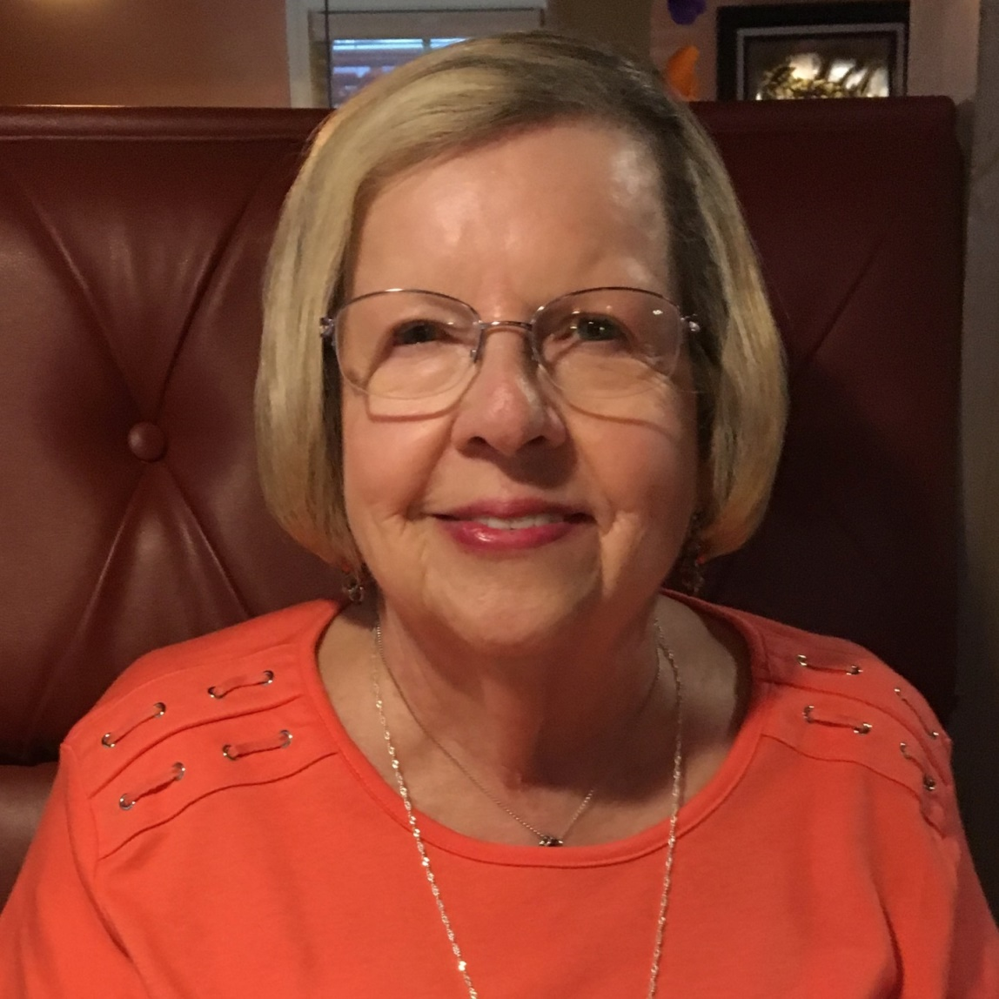
Carley Asberry
Notes:
57

Slide 58
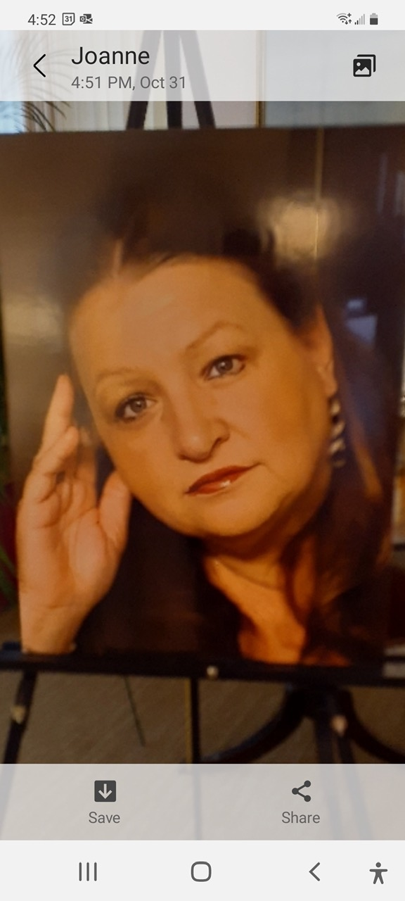
Sandra Clark
Notes:
58

Slide 59
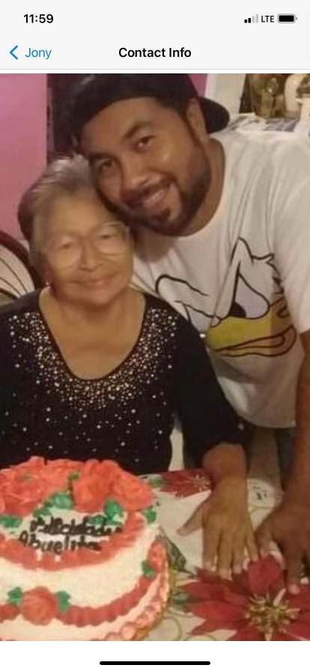
Conradina Pelcastre De Garcia
Notes:
59

Slide 60
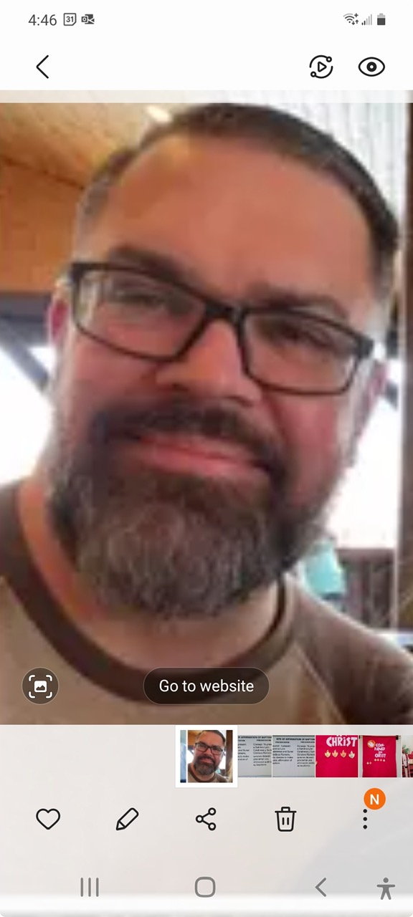
William Garcia
Notes:
60

Slide 61
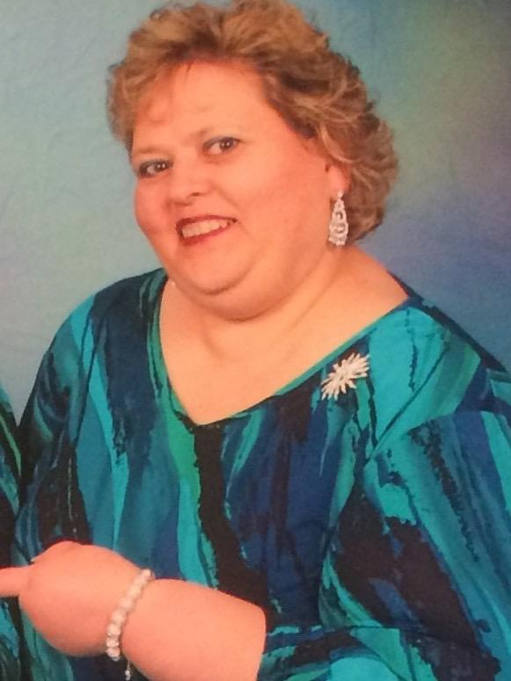
Lisa Michelle Henry
Notes:
61

Slide 62
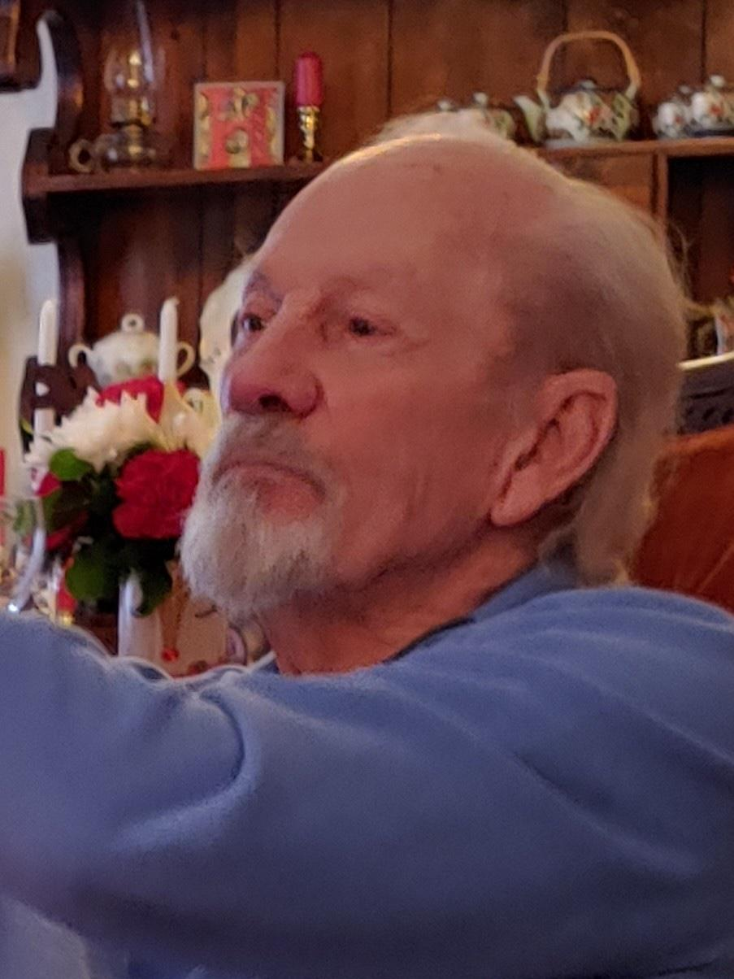
Robert Elwood Larch
Notes:
62

Slide 63
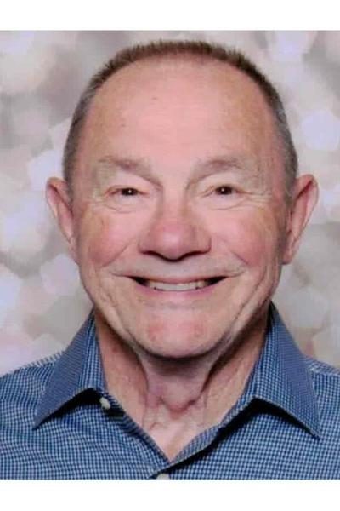
William McKenny
Notes:
63

Slide 64
Inez Nesbitt
Notes:
64

Slide 65

Carolyn O’connor
Notes:
65

Slide 66
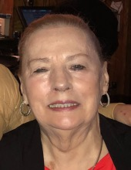
Ruth Parente
Notes:
66

Slide 67
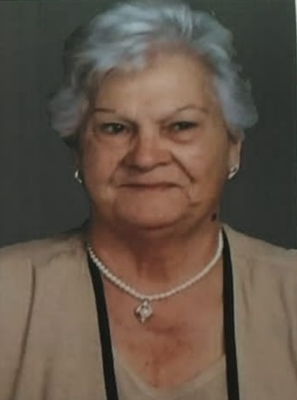
Filomena Papparella
Notes:
67

Slide 68
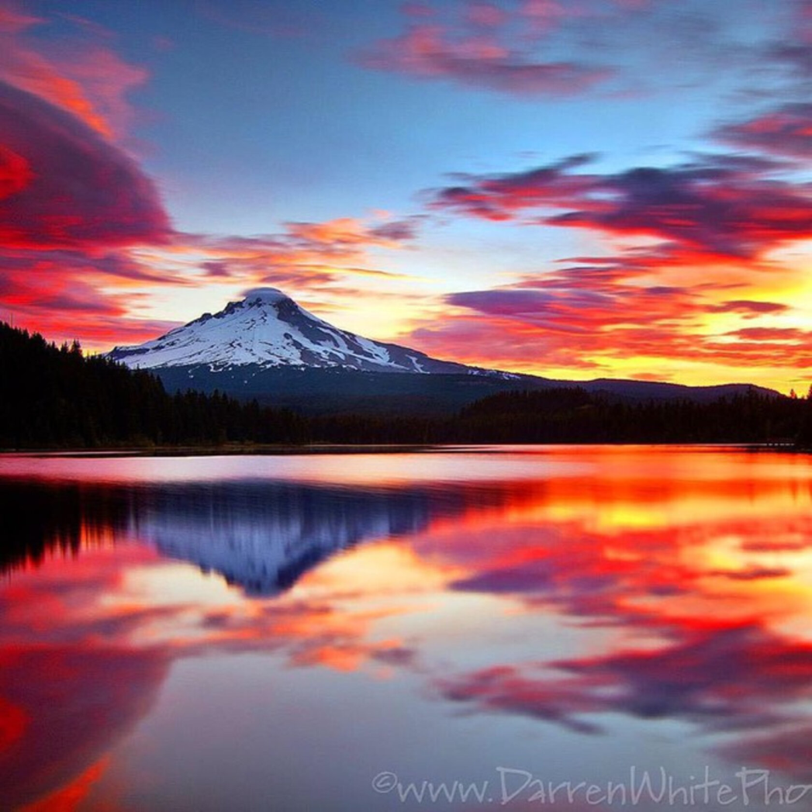
Jose Luis Garcia Pelcastre

Slide 69
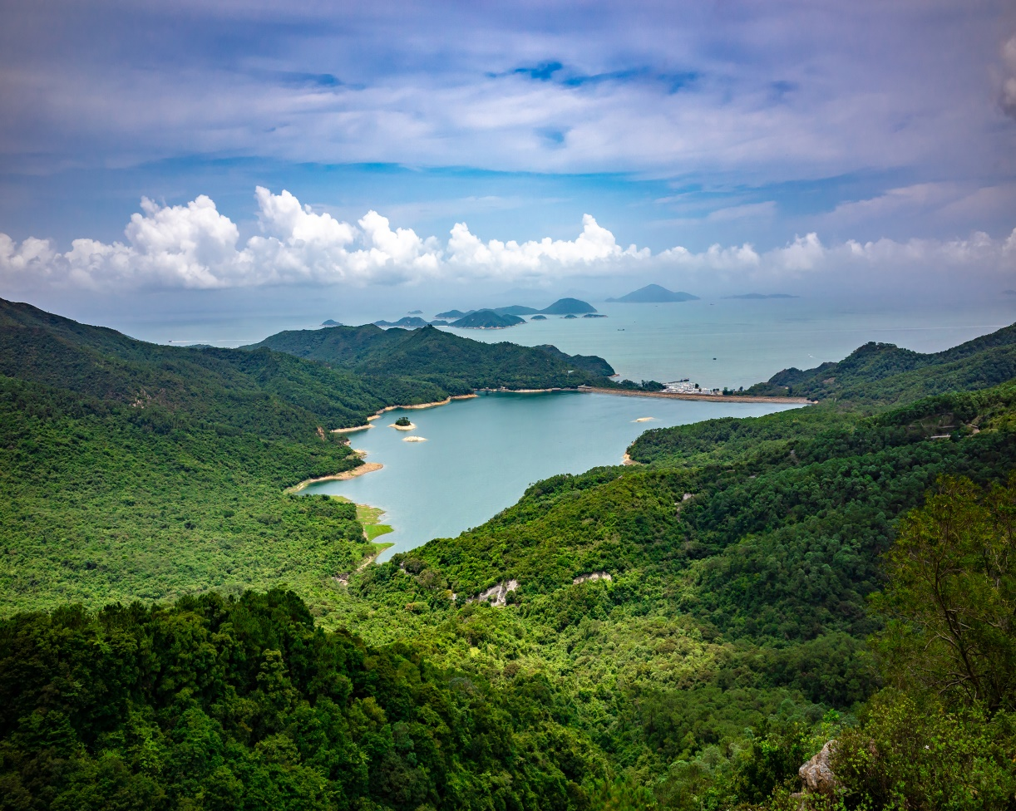
Fidel Robledo
Notes:
69

Slide 70
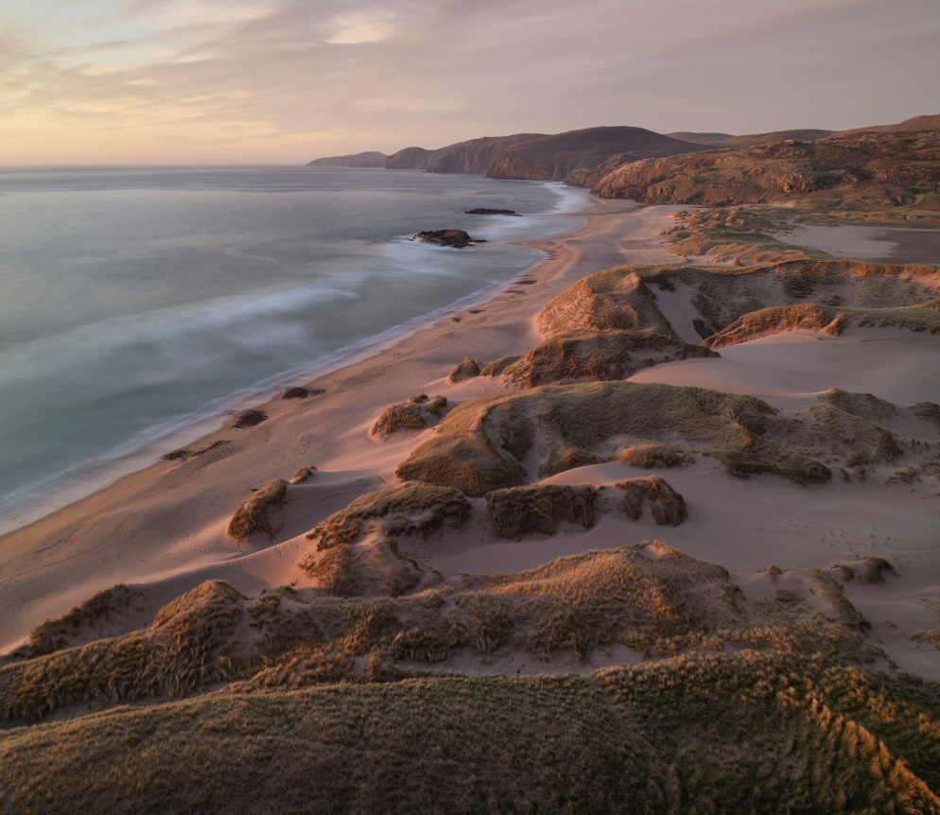
Pablo Robledo
Notes:
70

Slide 71
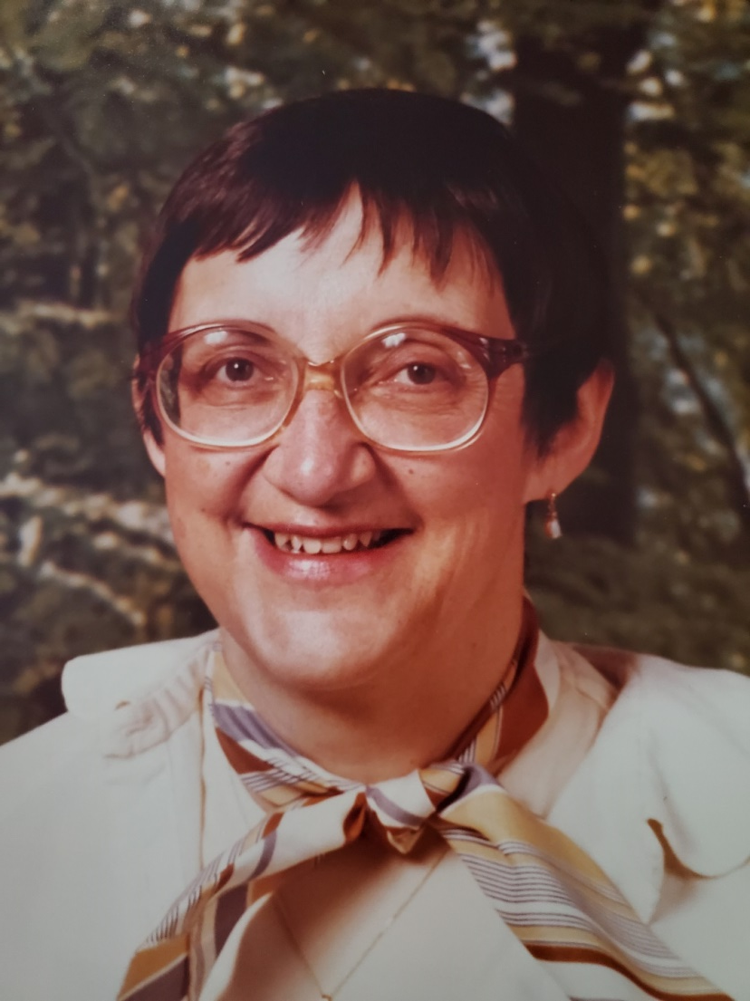
Carol Schwartz
Notes:
71

Slide 72
Arlene Usry
Notes:
72

Slide 73
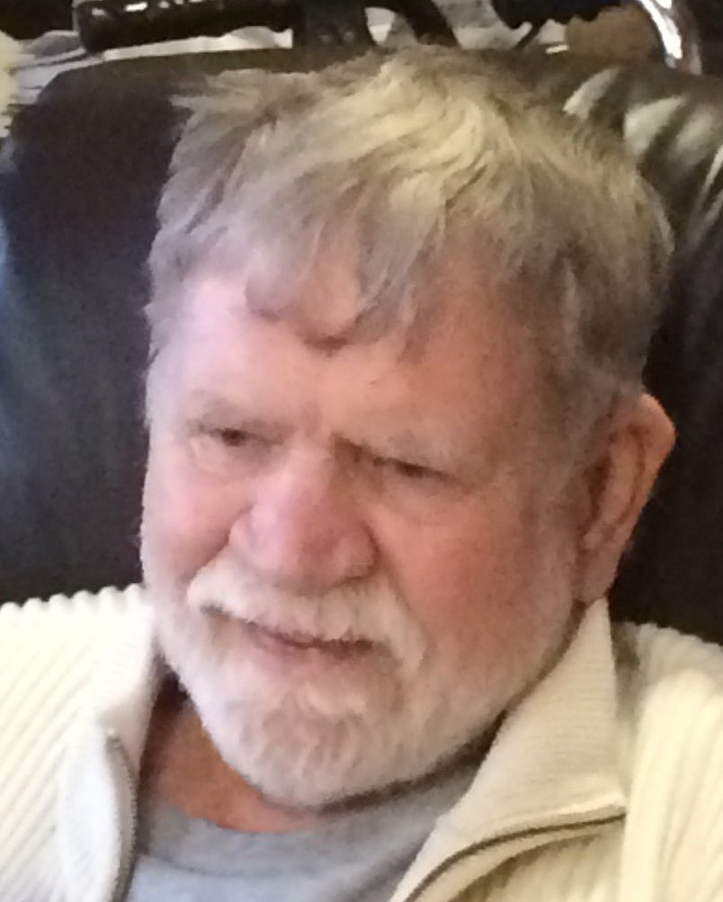
David Wroolie
Notes:
73

Slide 74
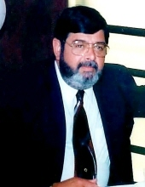
Fred Winans
Notes:
74

Slide 75
NAMING THE HONORED DEAD
P: O God of both the living and the dead,
We praise your holy name for all your servants
who have finished their course in faith.
We pray that, encouraged by their faith and example and strengthened by their fellowship,
we may be partakers with them of the inheritance of the saints in light; through the victory won by your Son Jesus Christ our Lord.
C: Amen.
Notes:
75

Slide 76
NAMING THE HONORED DEAD
Carley Asberry
Sandra Clark
Conraadina Pelcastre De Garcia
William Garcia
Lisa Michelle Henry
Robert Elwood Larch
William McKenny
Inez Nesbitt
Carolyn O'connor
Ruth Parente
Filomena Papparella
Jose Luis Garcia Pelcastre
Fidel Robledo
Pablo Robledo
Carol Schwartz
Arlene Usry
David Wroolie
Fred Winans
Notes:
76

Slide 77
The Apostle’s Creed
Credo Apostólico
I believe in God, the Father almighty, creator of heaven and earth.
I believe in Jesus Christ, his only Son, our Lord.
He was conceived by the power of the Holy Spirit and born of the virgin Mary.
Creo en Dios, el padre todopoderoso, creador del cielo y de la tierra.
Creo en Jesucristo, su único hijo, nuestro Señor. Fue concebido por el poder del Espíritu Santo y nacido de la Virgen María.
Notes:
77

Slide 78
The Apostle’s Creed
Credo Apostólico
He suffered under Pontius Pilate, was crucified, died, and was buried. He descended into hell. On the third day he rose again. He ascended into heaven, and is seated at the right hand of the Father. He will come again to judge the living and the dead..
Sufrió bajo Pontius Pilato, fue crucificado, murió y fue enterrado. Descendió al infierno. Al tercer día se levantó de nuevo. Ascendió al cielo y está sentado a la diestra del padre. Volverá a juzgar a los vivos y a los muertos.
Notes:
78

Slide 79
The Apostle’s Creed
Credo Apostólico
I believe in the Holy Spirit, the holy catholic Church, the communion of saints, the forgiveness of sins, the resurrection of the body, and the life everlasting. Amen.
Creo en el Espíritu Santo, la santa iglesia católica, la comunión de los santos, el perdón de los pecados, la resurrección del cuerpo, y la vida eterna. Amén.
Notes:
79

Slide 80

THE PRAYERS OF THE CHURCH
After each petition of the prayer:
A: God of beginnings and endings,
C: Make all things new.

Slide 81
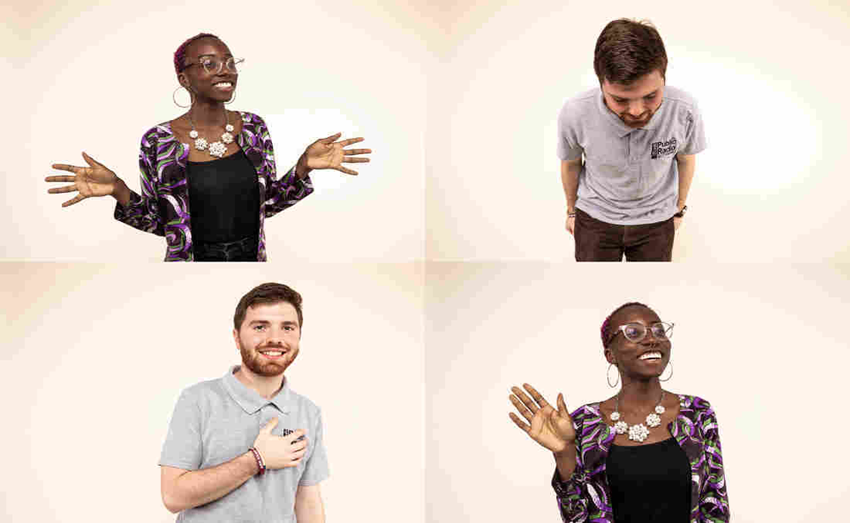
SHARING OF THE PEACE
COMPARTIENDO LA PAZ
A time to greet each other with God’s peace.
P: The peace of the Lord Jesus Christ be with you.
C: And also with you.

Slide 82
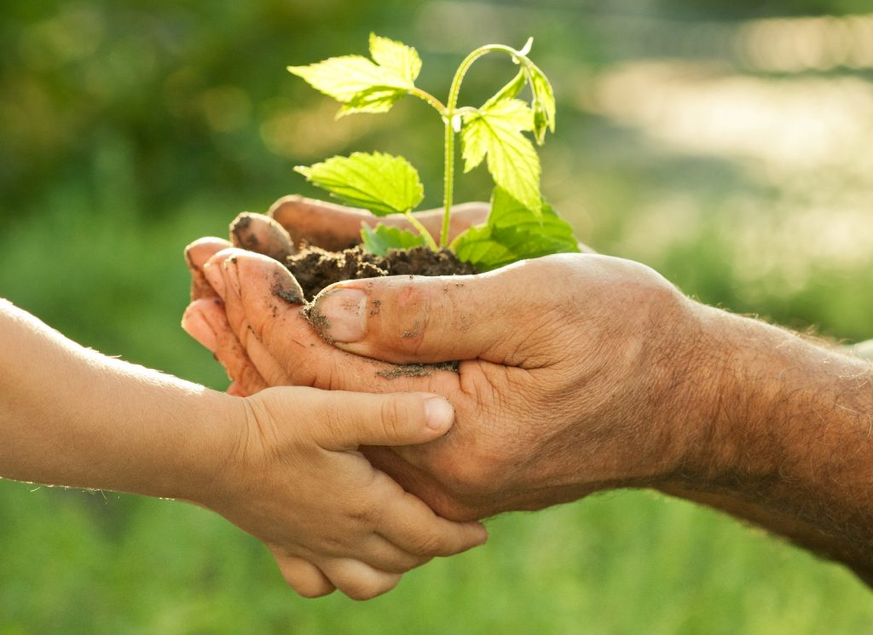
WE GATHER THE OFFERING
Your offering contribution enables us to support and
continue the many ministries of Amazing Grace.
Thank you for your offering of worship.
You can also give your offering digitally through Zelle: digital_giving@tisgrace.org
Notes:
Early

Slide 83
OFFERING PRAYER
P: O Lord,
C: we thank you for those who chose the way
of Jesus Christ.
In the midst of trial, they held out hope,
In the midst of hatred, they kindled love;
In the midst of despair, they clung to your
promise.
For your love and faithfulness we will at all
times praise you.

Slide 84
OFFERING PRAYER
We also thank you for the saving truth they passed on to us.
In gratitude for these and all your many blessings we respond in thanksgiving with these offerings and we renew our pledge
to follow the way pioneered by the faithful who came before us and to be good stewards of their lessons, teaching and experiences,
in the name of Jesus Christ, through whom we are called saints. Amen.

Slide 85
CELEBRATION OF HOLY COMMUNION
THE WORDS OF JESUS
P: In the night in which he was betrayed, our Lord Jesus took bread, and gave thanks; broke it, and gave it to his disciples, saying: “Take and eat; this is my body, given for you.
Do this in remembrance of me.”
P: Again, after supper, he took the cup, gave
thanks, and gave it for all to drink, saying: “This cup is the new covenant in my blood, shed for you and for all people for the forgiveness of sin.
Do this in remembrance of me.”

Slide 86
THE LORD’S PRAYER
PADRE NUESTRO
P: In the language of your heart, let us pray the prayer that Jesus taught us:
C: Our father, who art in heaven, hallowed be thy name. Thy kingdom come, thy will be done, on earth as it is in heaven.
P: En el idioma de tu corazón, rezamos la oración que Jesús nos enseñó:
C: Padre nuestro, que estás en el cielo, santificado sea tu nombre. Hágase tu voluntad en la tierra como en el cielo.

Slide 87
THE LORD’S PRAYER
PADRE NUESTRO
Give us this day our daily bread, and forgive us our trespasses, as we forgive those who trespass against us.
Danos hoy nuestro pan de cada dia. Perdona nuestras ofensas como también nosotros perdonamos a los que nos ofenden.

Slide 88
THE LORD’S PRAYER
PADRE NUESTRO
And lead us not into temptation but deliver us from evil. For thine is the kingdom, and the power, and the glory, forever and ever. Amen.
No nos dejes caer en tentacion y libranos del mal. Porque tuyo es el reino, tuyo es el poder y tuya es la gloria, ahora y siempre, amen.

Slide 89
INVITATION TO COMMUNION
P: Come to share the feast at the
Lord’s Table with all the saints!

Slide 90
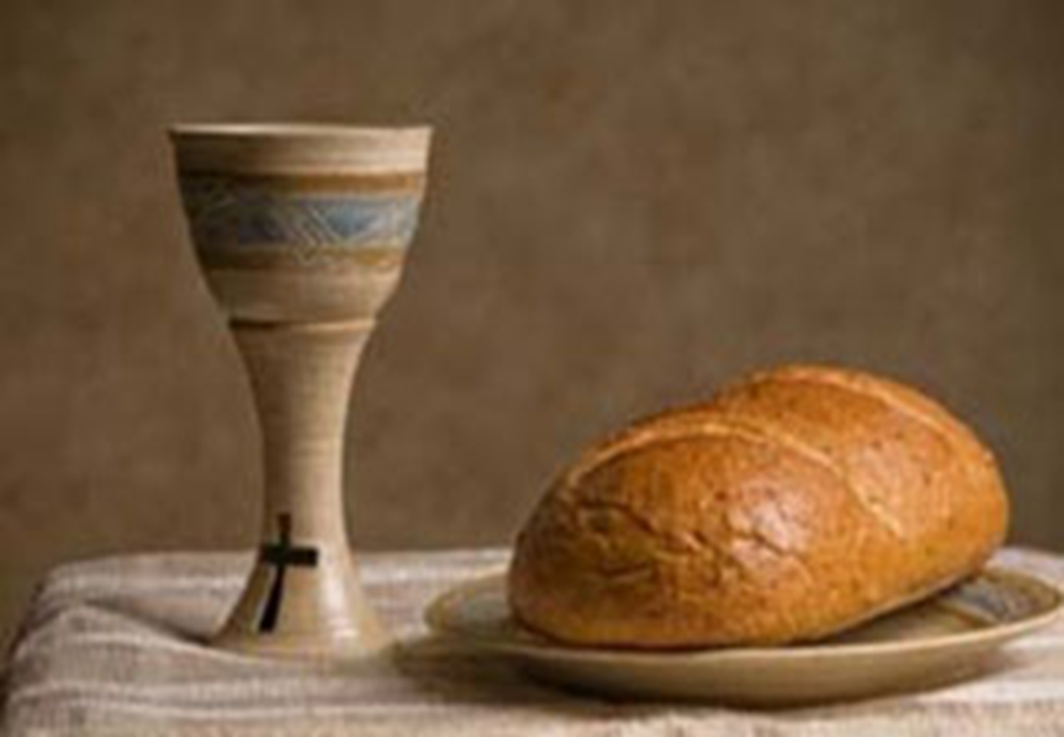
THE MEAL

Slide 91
LAMB OF GOD

Slide 92
POST COMMUNION PRAYER
P: Almighty and merciful God,
C: through his body and blood your Son has opened for us a new and living way into your presence.
Give us pure hearts and a sure faith
to draw near to you as our Father,
and to ask you for whatever we need.
We ask this through your Son, Jesus Christ our Lord, who lives and reigns with you and the Holy Spirit, one God, now and forever. Amen.

Slide 93
SENDING SONG
This Is a Day of New Beginnings
This is a day of new be - gin-nings, time to re – mem - ber and move on, time to be - lieve what love __ is bring - ing, lay - ing to rest the pain that’s gone. new.
Notes:
93

Slide 94
SENDING SONG
This Is a Day of New Beginnings
2 For by the life and death of
Je - sus, love’s might - y
Spir - it, now as then, can make for us a world __ of
dif – f’rence, as faith and hope are born a - gain.
new.
Notes:
94

Slide 95
SENDING SONG
This Is a Day of New Beginnings
3 Then let us, with the Spir - it’s dar - ing, step from the past and leave be - hind our
dis – ap – point -ment, guilt, and griev - ing, seek - ing new paths, and sure to find.
Notes:
95

Slide 96
SENDING SONG
This Is a Day of New Beginnings
4 Christ is a – live and goes
be – fore us to show and share what love can do. This is a day of new __ be – gin – nings; Our God is mak - ing all things new.
Notes:
96

Slide 97
SENDING SONG
This Is a Day of New Beginnings
5 In faith we’ll gath – er ‘round the ta – ble to taste and share what love can do. This is a day of
new __ be – gin – nings; Our God is mak – ing all things new.
CCLI Song # 231043 Hope Publishing Company
Words by Brian Arthur Wren; Music by Carlton Raymond Young
Notes:
97

Slide 98
BLESSING AND SENDING
P: God’s people have celebrated all that God
has done, from creation, to the cross, to the
saints who have lived among us.
Now we go from this place to the workplace,
the home place, the marketplace; every
place living as God’s own people.
The blessing of God Most Wonderful, whom
the saints have trusted as Father, Son and +
Holy Spirit, will be with you now and evermore. C: AMEN.

Slide 99
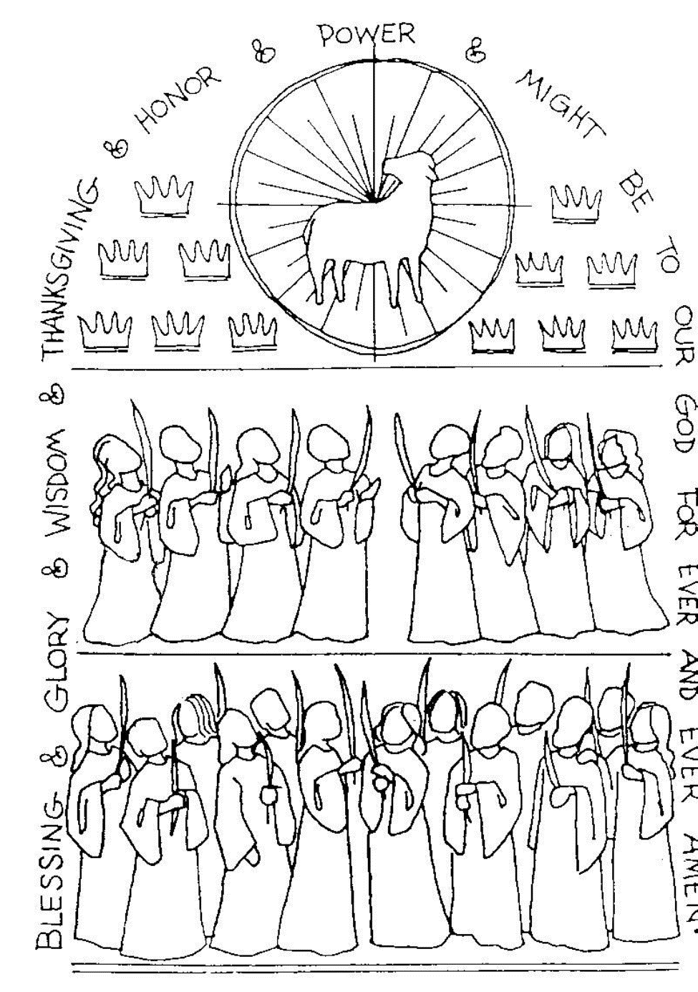
DISMISSAL
A: Go in peace to serve God and your neighbor after the example of the saints.
C: Thanks be to God!

